Slide 1

Budget heading 04.03.03.03 “Information, Consultation and Participation of Representatives of Undertakings
Call for proposals VP/2012/003
MuMMIA – Multisectoral Multinationals Managing Information&Consultation Agreements
Enhancing trade union capacity building for adapting to dynamic and cross-border TNCs
Project Promoter:
FILCAMS CGIL - Italy
Partners:
IRES CGIL ER – Italy
CHTJ-UGT – Spain
KOOP-IS – Turkey
LBC-NVK – Belgium
FGA-CFDT – France
FSC-CCOO – Spain
CGIL Lombardia – Italy
Supporting organisations:
ETUC
EFFAT
EMF-FEM
UNI-Europa

Slide 2
MuMMIA project
STARTING POINT
the number of multinationals covered by the Directive 2009/38/EC...
There is a gap between
...and the number of EWCs installed
Indeed, the ETUI database records about 2,400 multinationals. 10% of those enterprises have a multi-sectoral perimeter (that rate rises up to 20% in case of groups of enterprises).
Currently, there are only 900 active EWCs (many of them have to be rengotiated after the transposition of the EWC Directive into national laws).
About 1,500 TNCs are covered by the EWC Directive, but do not have EWCs.
In 20 years about 1,200 EWCs have been installed (an average of 60 per year)
At the moment, there are only 50 ongoing negotiations.

Slide 3
MuMMIA project
Which are the causes of such a situation?
The factors that obstruct the establishment of EWCs in cross-border TNCs are several. We can distinguish between:
OBJECTIVE FACTORS (linked to the complex structure of the TNC)
SUBJECTIVE FACTORS (regarding the diverging orientations, priorities and capacities of the actors involved)

Slide 4
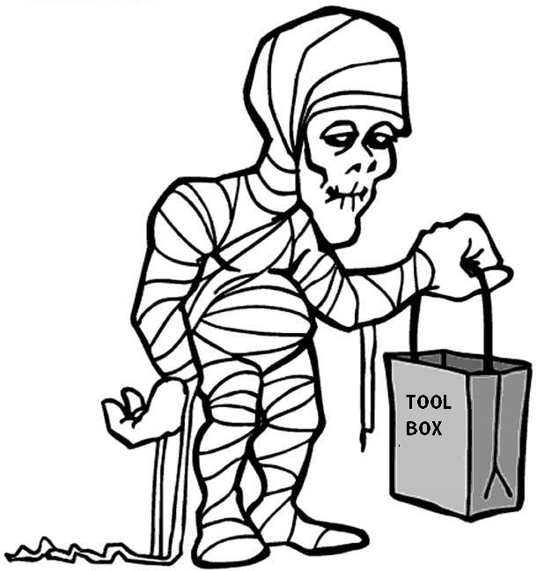
MuMMIA project
Compared to transnational companies that increasingly change their sectoral and geographical perimeter, trade unions seem to move slowly like a MUMMY
The toolbox they have is not up to the challenges to be faced!

Slide 5
MuMMIA project
In order to adapt to the cross-nationality and the cross-sectorality of the big companies, trade unions need to strengthen their alliances!
We have to build strong networks among National and European Trade Unions operating in different sectors. That is crucial to successfully establish EWC agreements in cross-border transnational companies and enable workers to exercise their information and consultation rights at company level.

Slide 6
MuMMIA project
THANKS FOR YOUR KIND ATTENTION
For further information about the project:
Gabriele Guglielmi
gabriele.guglielmi@filcams.cgil.it
Massimo Frattini
massimo.frattini@filcams.cgil.it
FILCAMS CGIL ITALY

