Slide 1
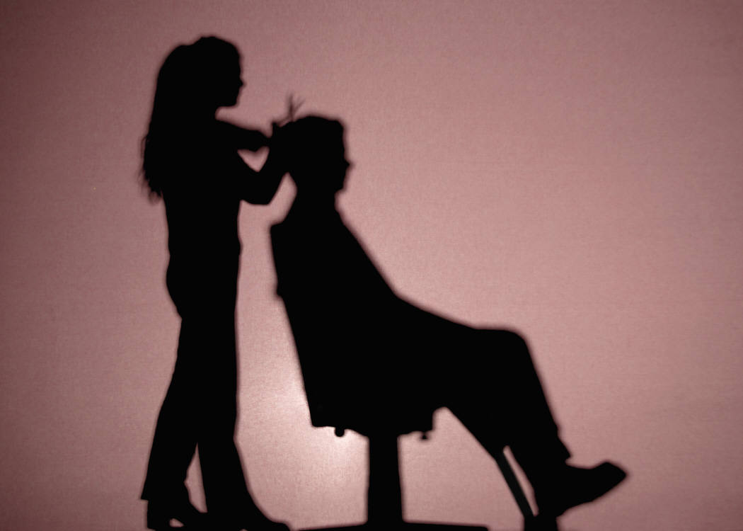
Study on social policy effects resulting from the scope of application of the European framework agreement on the prevention of health risks in the hairdressing sector
Final presentation to SSDC
Brussels 21st June 2011

Slide 2
Key Question
Should all hairdressers be covered by the provisions of the European sectoral social partner framework agreement?
What would be the consequences if only certain segments of the sector were covered?

Slide 3
Impact of different implementation options?
What share of the sector would be covered?
Would large segments of the sector be excluded from improvements?
Would it lead to distortions of coverage between different countries?
Social policy goals of the EU
Reduce quality of work (crowding out, training provision)?
Detrimental effect on health and safety in segments not covered (health insurance)?
Competition
Distortions of competition (including through impact on consumer perception)?

Slide 4
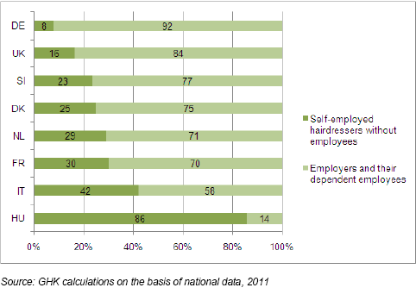
What share of the sector would be covered?

Slide 5
What share of the sector would be covered (cont’d)
Importance of the practice of chair-renting in the hairdressing sector
Illegal | Marginal | More widespread
Denmark (Italy) | France Netherlands | Germany Hungary Slovenia United Kingdom

Slide 6
What share of the sector would be covered (cont’d)
Share of mobile hairdressers in total hairdressing workforce
Country | Share of mobile hairdressers
Denmark | Approx. 1-2%
France | 6.4%
Germany | No data
Hungary | No data
Italy | No such practice (only if other registered place of business)
Netherlands | 8-23%
Slovenia | No such practice
United Kingdom | Approx. 5%

Slide 7
What share of the sector would be covered - summary
Option 1
Between 76-79% of the sector covered (ranging from 14%-92%)
SIGNIFICANT DIFFERENCES IN IMPACT BETWEEN COUNTRIES
Option 2
SMALL IMPACT as phenomenon is marginal in most countries
Option 3
Between 8-86% of workers would be covered additionally
SIGNIFICANT DIFFERENCES IN IMPACT BETWEEN COUNTRIES
Option 4
Between 0-23% of workers covered additionally,
RELATIVELY SMALL IMPACT BUT SOME COUNTRY VARIATION

Slide 8
Impact on EU social policy goals
Do countries which apply health and safety legislation only to dependent employees have more micro-business, chair renters etc?
Is there evidence that changes in health and safety legislation have significantly impacted the cost base of the sector?
How many countries would have to change their health and safety legislation?
What is the added cost of EU agreement?

Slide 9
Coverage of self-employed by h&s legislation (first √) and statutory occupational health insurance (second √)
Country/type of hairdresser | Employers and dependent employees | Self-employed without employees | Self-employed in same establishment with employees | Mobile
D | √ √ | √ √ | √ √ | √ √
DK | √ √ | √ | √ | √
F | √ √ | √ √ | √ √ | √ √
HU | √
IT | √ √ | √ | √ | √
NL (current attempts to include s/e) | √ √
SI (possible new legislation to exclude s/e) | √ √ | √ √ | √ √ | √ √
UK | √ | √ | √ | √

Slide 10
National health and safety legislation – impact of European agreement
 | General or specific legislation | Law, collective agreement or guidance (specific provision) | Impact of agreement
D | Specific | Law | Limited
DK | General | N/a | Likely limited
F | Specific | Law and collective agreement | Some impact
HU | General | N/a | Likely limited
IT | Specific | Guidelines | Some impact
NL | Specific | Collective agreement | Limited
SI | Specific | Law | Limited
UK | Specific | Guidance | Likely limited

Slide 11
Crowding out effect?
  Baseline evidence does not show clear link between scope of application of health and safety legislation and structure of sector – relevance of other factors
  HU has highest share of self-employed without dependent employees, but in NL share is only 4th highest.
  Data on chair renters and mobile hairdressers difficult to link to health & safety legislation.
  Only available evidence on cost impact of health and safety legislation points to some cost reduction for the sector.

Slide 12
Crowding out effect?
“Crowding out” effect?
  General trend is towards micro-salons (and to a lesser extent larger salons) with exception of DK
  However, appears that increasing trend towards micro-salons and chair renting driven by economic and societal change, legislation/policies encouraging self-employment and training regulations rather than h&s regulation

Slide 13
Crowding out effect?
“Crowding out effect”
  Based on information from the study countries the non-application of h&s legislation to specific segments of the sector does not seem to be of significance
  Little evidence on impact of health and safety legislation on cost structure (and differential cost structure of sector) – likely to have limited impact, but we have little information on impact of cost of “one off” items

Slide 14
Crowding out to underground economy?
  Evidence on undeclared work is scant, estimates indicate that it is relatively high (including by those also doing declared work) but appears that this is driven more by tax considerations rather than h&s regulation
  Insufficient evidence with regard to distortion of competition (could customers be forced to chose between lower costs and higher h&s standards)

Slide 15
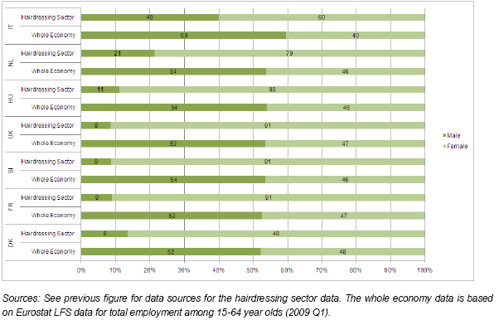
Impact on equality
Notes:
Self-employment declining in DK - according to the Danish Hairdressing Federation, the decrease of the one-person businesses is linked in particular to the financial crisis, to the vulnerability of working alone and to the administrative burden of running a one-person salon.

Slide 16
Impact on equality and training provisions
Sector is dominated by women, so there would be differential gender impact
Sector is dominated by young, relatively low paid workers
Insufficient evidence of “threshold effect” with regard to training

Slide 17
Impact on health and safety
Are there significant differences in the health and safety performance of different segments of hairdressing sector?
Can this be shown to be linked to coverage of legislation ?
What has been the impact of the introduction of recent changes in legislation?

Slide 18
Data on health and safety performance
Data on number of accidents and work related illness not comparable and not broken down by type of employment
Skin and respiratory disorders most common and between 5-30% more prevalent than in other sectors
Some anecdotal evidence that self-employed without employees are less aware of legislation – could be differential impact on those not covered
Cost of absence calculated at approx. 13,500 EUR per year.

Slide 19
Impact of health and safety legislation
Only study on impact of health and safety legislation on costs from Germany
  Regular cost associated with skin protection: 1.2% of turnover of average business
  Costs outweighed by benefits?: Cost for occupational health insurance decreased (as a result of a decline in work related ill health) following introduction of specific h&s regulation in the sector

Slide 20
Impact on occupational health insurance
Germany and Slovenia cover all those working in the sector by the same statutory insurance
France has separate statutory insurance for self-employed
In all other countries insurance for self-employed is voluntary
Actuarial distortions could arise in systems where only certain segments are covered by specific legislation but are insured by same insurance

Slide 21
Conclusions
Share of self-employment in the sector is significantly higher than in the whole economy (between 20 and 50% higher) and between 2-20% greater than in other service sectors
Some occupational illnesses significantly more widespread in this sector (5-30 times)
Some evidence that awareness of risk and incidence of ill health and accidents greater among self-employed without employees
Could lead to distortions in occupational health insurance in certain systems
Impact greater where self-employed are not generally covered and their number is high

Slide 22
Conclusions
Differential application of health and safety legislation to different segments of the market in hairdressing not main factor conditioning the diversified profile of the sector in different countries. Instead, this seems to be affected by the overall economic climate, policy measures and regulations to support self-employment and entrepreneurship and tax and VAT regulations.
Available information shows cost of implementation likely to be low (but little evidence on impact of big ticket items)

Slide 23
Conclusions
Limitations of the study
Restricted number of countries (8); information from additional countries would be valuable (particularly on current coverage of self-employed)
Limited evidence base on h&s risks regarding different segments of the sector

Slide 24
Thank you

